Slide 1
Repair and Modification of Primary Composite Structural Components – Substantiation Complexities for Non-OEMs Within the Scope of both Field Approvals and STC Projects
Stephen Forness
Managing Director –
Air Flight Technical LLC

Slide 2
Where Would Someone Start
Complexity of the Problem
Antenna vs Major PSE(s) Modification
STC vs Field Approval
Design, Manufacturing, Quality Assurance
Material Properties
Structural Substantiation (Static, Fatigue, and
Damage Tolerance)

Slide 3
Original Manufacture Information
Ply Layup
Material(s) Used
OEM material properties used in original design. (Including all building block test)
OEM BVID Results used in Damage Tolerance Design
Design Loads – External
Design Loads - Internal
Defects covered by OEM MRB and allowed to remain that can affect the repair or modification

Slide 4
What Will Be Needed
STC
Process Specifications
Material Qualification
Inspection Methods
C-Scan
A-Scan (What limitations does this cause)
Detail Part Manufacturing
Curing Methods (Autoclave, Oven-
Vacuum, and Room Temperature)
Trimming
Field Approval – All process Specification on Drawings

Slide 5
Material Properties
Equivalence (70 K $) – Basic OEM Laminate
Complete Basic Material Properties (CMH-17
Data Set) (150 K $)
Building Block Approach for Each Modification Or Repair (25-150 K $)
MRB (e.g. property reduction due to
porosity)

Slide 6
Process Specifications
Assembly Processes
Bonding
Drilling
Priming
Painting
Decal Application
etc.

Slide 7
Design
Details Needed on Drawings
Ply Flat Patterns
Finish Article Ply Location
Assemblies / Installations
Inspection prior to modification
Callout of all appropriate Process
Specification

Slide 8
Quality Assurance
Inspection Requirements – Detail Parts, Assembly, Installations
Inspection Methods – C-Scan, A-Scan, etc.
MRB Manual / Procedures

Slide 9
Inspection Used – Before and After
Need to first assess the existing structural integrity,
C-Scan or A-Scan
Second to ensure quality of the repair or modification
C-Scan or A-Scan

Slide 10
Design Issues
Location Selection
Minimize complexity as much as possible
Less is more – Minimize effect on existing Load
Path
Clearly present work plan for correct installation (Utilize SRM Methods and procedures as much as possible)
Replace Lightning protection

Slide 11
Structural Substantiation
FEM (Load Distribution Only)
Bi-axial loads needed (not just hoop)
Close Form Solutions
Details analysis
Failure Criteria
Bonded Joint analysis
Bearing / Bi-Pass Curves based on
different layups
Damage Tolerance Substantiation

Slide 12
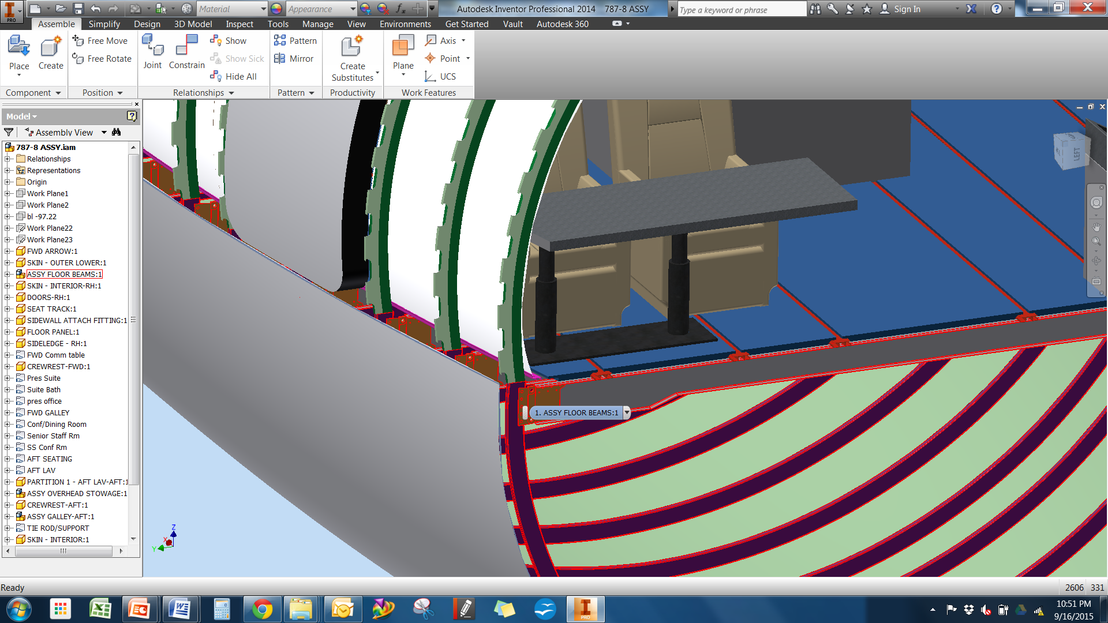

Slide 13
Effects of Defects Before and After
Effects on properties of porosity, voids and other manufacturing defects
Effects on properties of damage (Impact, Heat Damage etc)

Slide 14
Plan Differences between STC and Field Approvals
Material Properties
Inspection Techniques – Before and After
Design Issues
Analysis Methodologies
Effects of Defects Before and After
Process Specification for Bonding, Drilling, etc.
Experience of the Installation Mechanics

Slide 15
Possible Analysis Criteria Pyramid - Fuselage
Bolted Analysis – Bolt Loads / Bearing Bypass
Bonding Analysis (Peel /
Maximum Shear)
FEM – Validation (Load
Distribution Only)
Bird Strike (Analysis
and Test)

Slide 16
Possible Analysis Criteria Pyramid - Empennage
Flutter / Stiffness
Bonding Analysis (Peel /
Maximum Shear)
Aerodynamic
Smoothness
Weight / Re-Balance

Slide 17
Conclusion
Repairs and modification of primary aircraft structures will be performed without OEM assistance!!!

